Slide 1
Limits on leaf switch and ACI MCP protocol
CREATION DATE: YYYY-MM-DD

Slide 2
Background and problem statement
Background: After a Cisco ACI software upgrade alarming on the amount of VLAN’s with MCP started. The vlan amount was apparently exceeded for some time, but the upgrade enabled the alerting. Based on the alerting NTT and TCS Ops decided to hold any new deployments.
Problem statement: New deployment of vlans to customers are on hold, on certain leaf switches due to exceeding the by vendor described limits/boundaries.
Short summary of the problem:
(MCP)VLAN limits are being exceed on some leaf switches (N9k)(>2000vlans)
MCP (MisCabling Protocol) limits are being exceeded (ACI) (>256vlans)
Impact: Various customers cannot get vlan’s and therefore servers for their demands

Slide 3
Already in progress/executed
Cleanup vlans
Cleanup of un-used vlans will free up some space
Enabling on demand End Point Groups (EPG’s)
Changing EPG’s from static to on demand will free up the continuous load not peak load. And is best practice anyway
Result: Will free up some space, but not enough.
Currently clean up is still in progress by operations.
Next steps: see next slide

Slide 4
Next steps
For IT FC DEV END: Solution to disable MCP, safe to do
For IT Core FlexPod environment: 1. Solution to deploy with boundary conditions 2. Explore longterm solution

Slide 5
Next steps
# | Timing of solution | Solution idea | Advantages | Disadvantage | Comments/questions | Status | Owner
1 | Short term | 1.Clean up un-used VLAN’s 2. Enable EPG on demand instead of immediate provisioning | Will free up on short term | To be verified with Ops Small delay for users (booth up of VM/IP/MCP) few seconds (likely not noticeable) – its already the new standard for deployment Will not solve issue likely as limits are still expected to be exceeded | To be tested How much will it save on MCP? Runbook created, next step plan change (see actions) | Ongoing, being picked up by OPs | Ops
2 | Mid term | MCP Limit: Add additional VPC and port channels from FI to leaf N9K. To free up space for MCP limit | Ensure that vlans are within MCP | Will not solve 2000 leaf limit/issue (minimal) Downtime on flex pods where this is applied. Careful implementation required as can cause impact |  | Feature to be created for Design and PoC | Compute team (including connectivity) UCS/ACI/vSPHERE
3 | Mid term | Leaf limit: Add additional leaf (n9k), and split DTA and PRD loads across the leaf’s that are exceeding limits | Ensure that vlans are within leaf limits | Additional hardware investment Additional maintenance from DC side Complexity of configuration and maintenance increased (minimal) Downtime on flex pods where this is applied Careful implementation required as can cause impact |  | Feature to be created for Design and PoC | Compute team (including connectivity) UCS/ACI/vSPHERE
4 | Mid term | Configure FlexPods differently: FlexPod 10: Configure only PAAS VLANS on flexpod 10 ( stay below 256limit) FlexPod 9: Only add IAAS Vlans to flexpod 9 (below 256limit) | Relatively short term can be executed Stay within safe limits Able to continue deployment | Automation impact to be validated if it works or needs small adjustments to scripts for vlan’s If above proposal is implemented for how long can we safely proceed again till we reach limits FlexPod rebalancing will be impacted NTT needs be involved in some cases for vlan taggings to facilitate vm migration between some flexpods For how long can we continue? Introduce technical debt | Prioritize delivery of FlexPod 10 (alignment with TCS volume build) if we want to explore this route | tbd | Ops
4 | Mid/Long term | Upgrade ACI software to newer version with higher limits. | Vlans within limits both leaf and MCP and room to grow | Currently no “released maintenance” version available from Cisco only in between version. (Forecast Q2 to be released) | Align with Cisco to look for options to release correct version faster? | Cisco working on new version | Cisco and Datacenter connectivity team
5 | Long Term | Redesign of setup (Availability zone/set) / Appcentric setup | Long term scalability, future proof | Long lead time |  | tbd | Domain architects

Slide 6
ASIS – UCS Uplink connectivity - FXP
N9K – Leaf 1
N9K – Leaf 2
FI-A
FI-B
CH1
Server ports
Server ports
CH16

Slide 7
ASIS – UCS uplink connectivity - FXP
N9K – Leaf 1
DTAP VLAN
DTAP VLAN
N9K – Leaf 2
PO 10
PO 20
DTAP VLAN
DTAP VLAN
FI-A
FI-B
CH1
Server ports
Server ports
CH16
The VLAN 2000 is not because of UCS
The Current MCP is 350 per PO

Slide 8
Mid Term Solution 1
N9K – Leaf 1
N9K – Leaf 2
PO 10
PO 11
PO 11
PO 21
FI-A
FI-B
CH1
Server ports
Server ports
CH16

Slide 9
Mid Term Solution 1
Pros
Cons
We need to identify the free ports in FI , Leaf Switch
We need to segregate the DTAP VLAN
We need to involve the DC team to check the feasibility of the cable connectivity ( in case of Different rack )
We need to check the SFP modules
We need to change the UCS PO config ( very carefully or else lead to outage )
We need to introduce the new VLAN group, LAN pin Group and change in the service profile
We need to create a new vNIC template
We need to do the changes in the ACI config ( VPC )
Workload cannot be migrated to all the blades in the Flexpod ( as we are segregating the VLAN )
Unknown migration will lead to network disconnect of the VM
This will not solve the VLAN count issue
The Current MCP will be shared between the PO
This will help in cutting down the MCP to half between the PO
Efforts
Considering the above we would recommend this to go as a Project

Slide 10
Mid Term Solution 2
N9K – Leaf 3
N9K – Leaf 1
N9K – Leaf 2
N9K – Leaf 4
PO 11
PO 10
PO 20
PO 21
FI-A
FI-B
CH1
Server ports
Server ports
CH16

Slide 11
Mid Term Solution 2
Pros
Cons
Additional cost involved for the Leaf switch
DC team need to locate the space and power, cooling
Need to be in the same firmware code as it is like existing leaf
We need to segregate the DTAP VLAN
DC team to check the feasibility of the cable connectivity ( in case of Different rack )
We need to identify the free ports in FI
We need to check the SFP modules
We need to change the UCS PO config ( very carefully or else lead to outage )
We need to introduce the new VLAN group, LAN pin Group and change in the service profile
We need to create a new vNIC template
We need to do the changes in the ACI config ( VPC )
Workload cannot be migrated to all the blades in the Flexpod ( as we are segregating the VLAN )
Unknown migration will lead to network disconnect of the VM
This will solve the VLAN count issue
The Current MCP will be shared between the PO
This will help in cutting down the MCP to half between the PO
Efforts
Considering the above we would recommend this to go as a Project

Slide 12
FXP list in EID and HTC has the problem and Free ports
SW1 | SW2 | FlexPod | Available interfaces
221 | 222 | ufceid007_b | more than 10
221 | 222 | ufceid007_a | more than 10
311 | 312 | ufceid005_b | more than 10
311 | 312 | ufceid005_a | more than 10
407 | 408 | ufceid006_a | more than 10
407 | 408 | ufceid006_b | more than 10
415 | 416 | ufceid004_a | more than 10
415 | 416 | ufceid004_b | more than 10
803 | 804 | ufceid009b | more than 10
803 | 804 | ufceid009a | more than 10
813 | 814 | ufceid010b | more than 10
813 | 814 | ufceid010a | more than 10

Slide 13
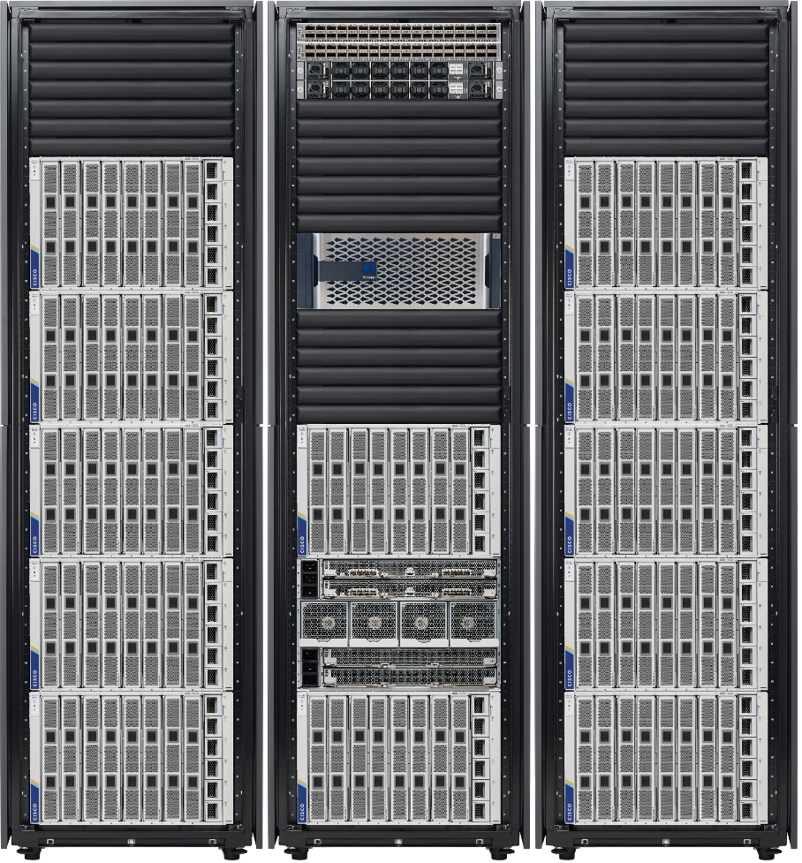
Observation
Observations
Compute is in one rack
Network is in different rack
Storage is in different room
These above will lead to cable extension
VLAN mapping in various LEAF
Complexing the setup
( It can’t be avoidable in such large landscape but with proper planning and design.,
Which can be minimized )
For that the proposal will be from compute will be LET US KEEP THE STACK SIMPLICITY

Slide 14
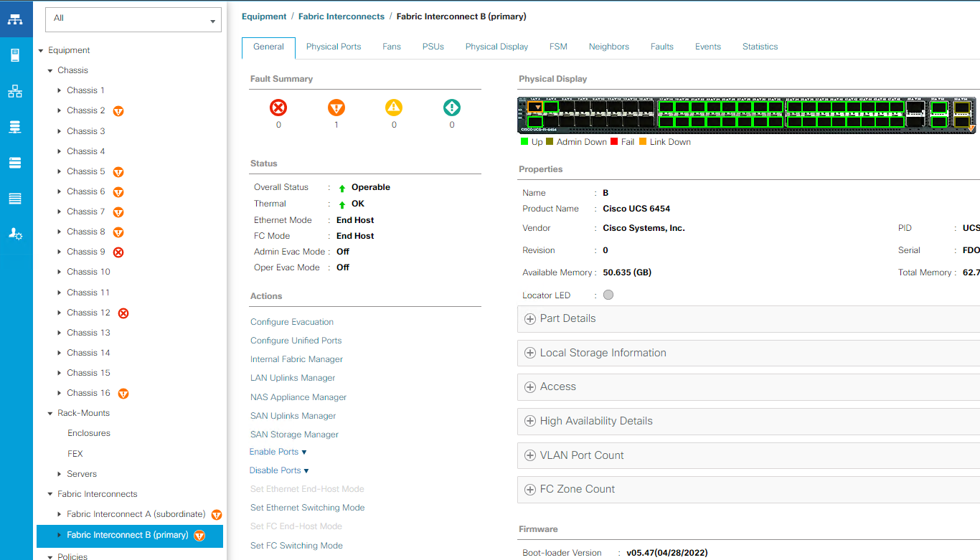
Config the Uplink ports

Slide 15
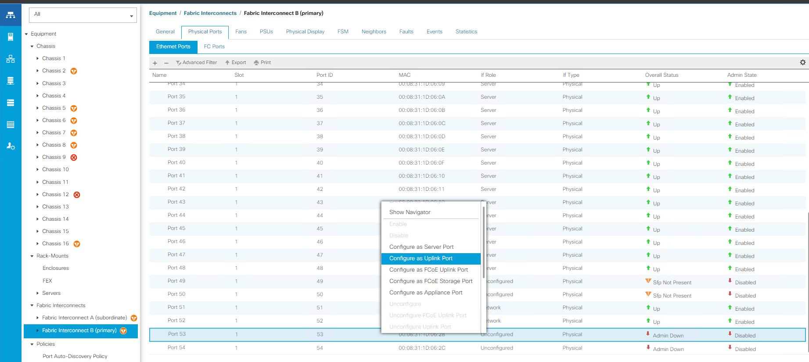

Slide 16
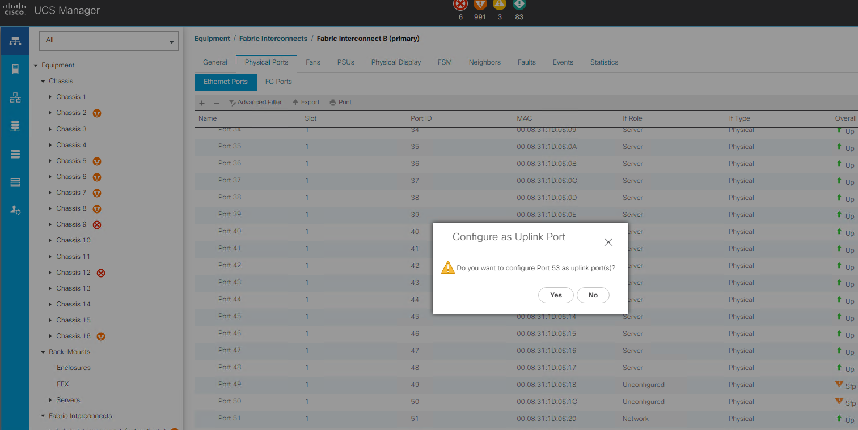

Slide 17
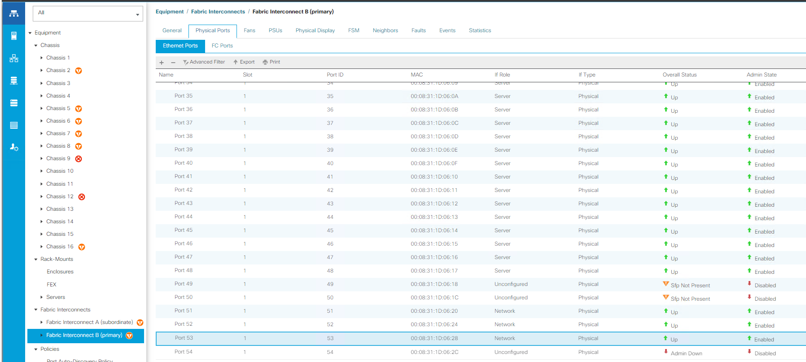

Slide 18
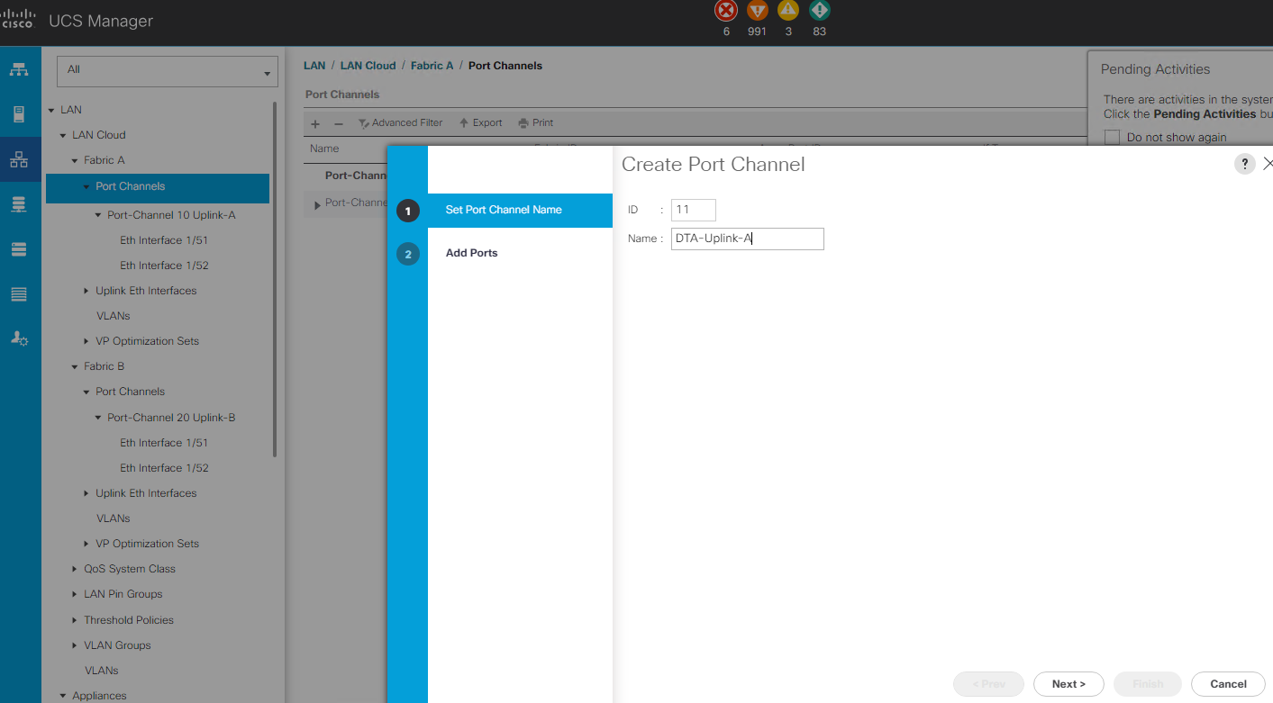
Config the Portchannel

Slide 19
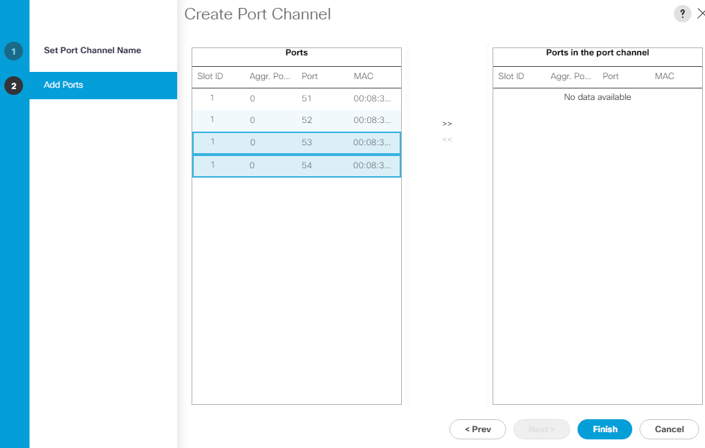

Slide 20
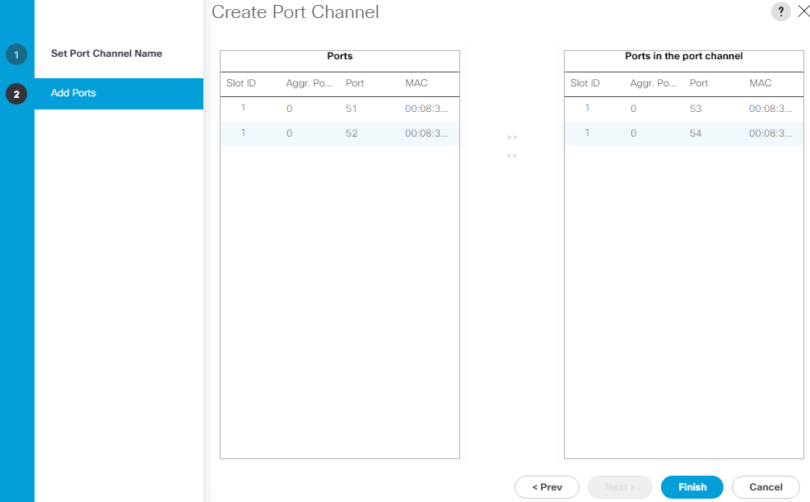

Slide 21
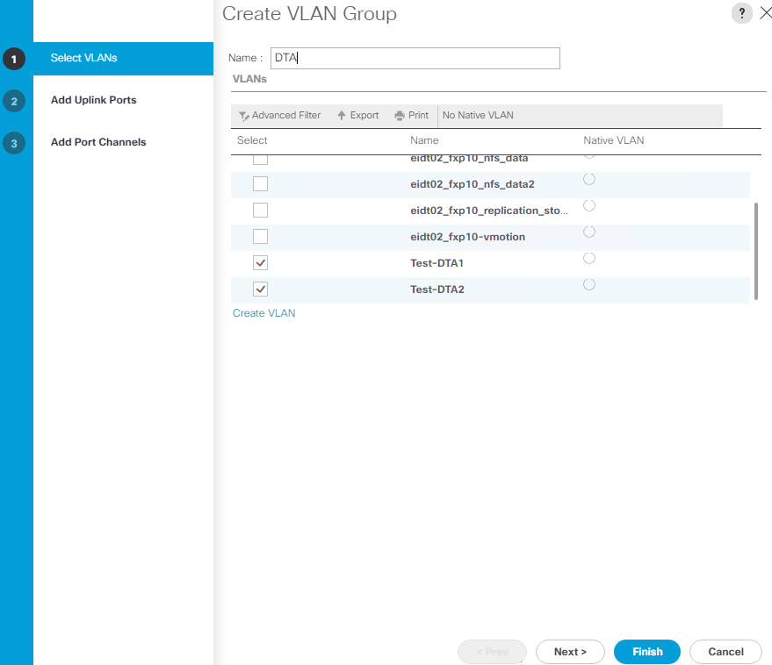

Slide 22
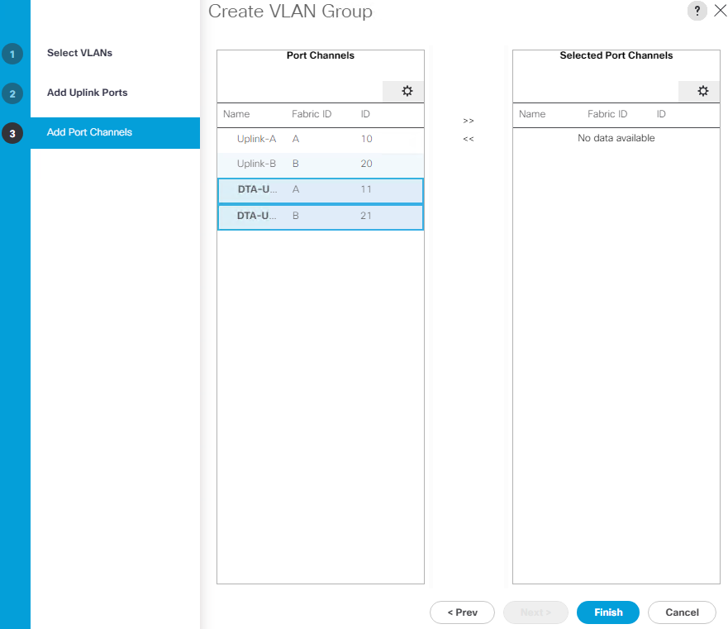

Slide 23
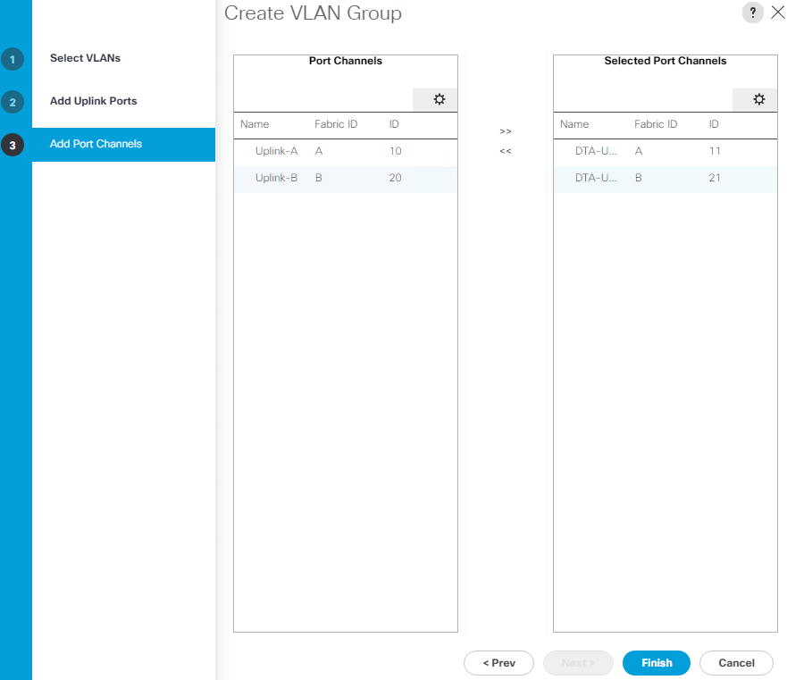

Slide 24
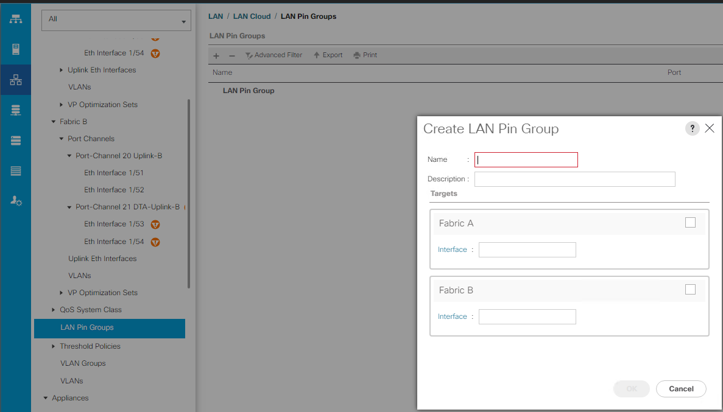
Config the LAN pin group

Slide 25
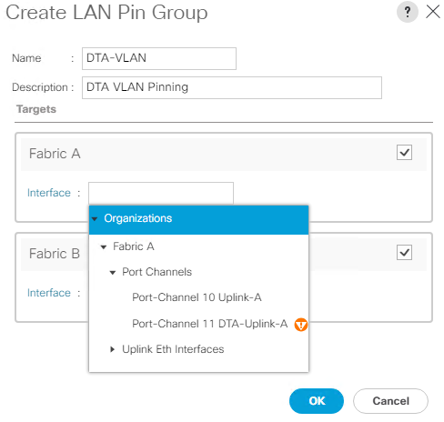

Slide 26
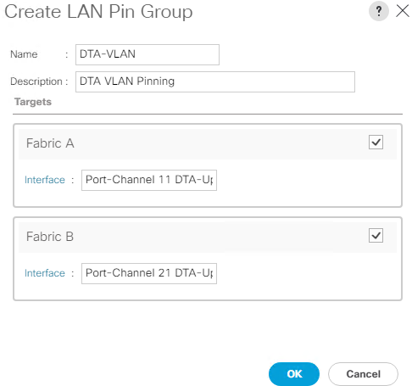

Slide 27
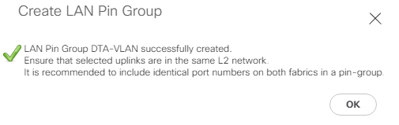

Slide 28
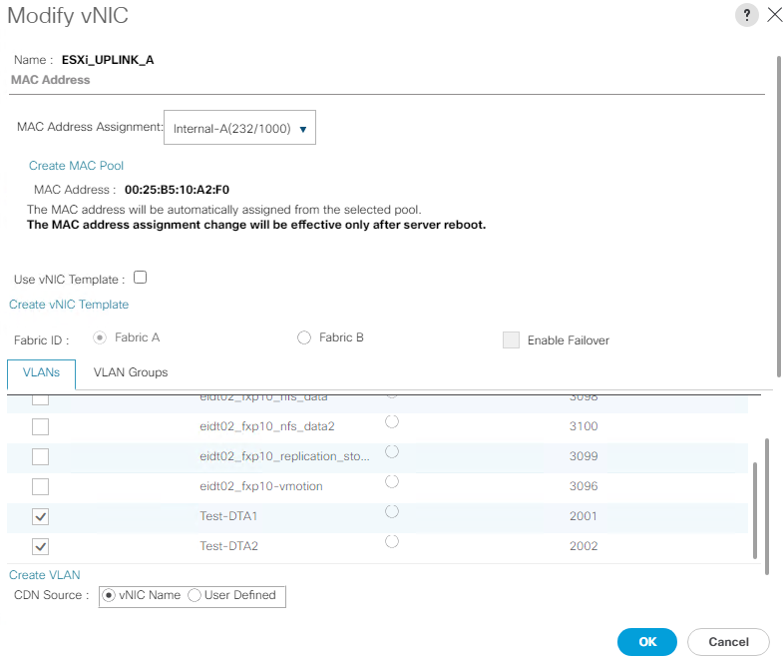
Config the vNIC

Slide 29
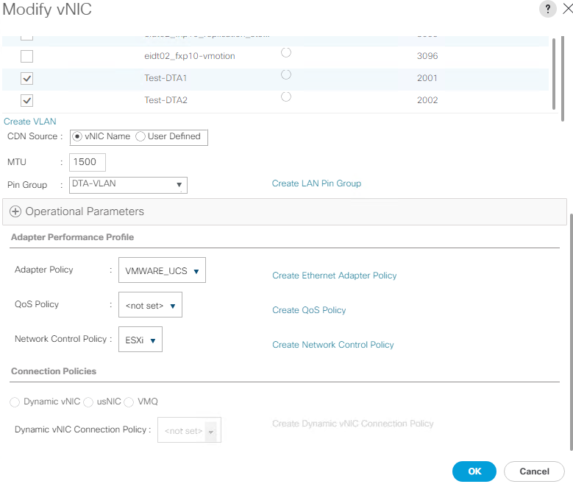

Slide 30
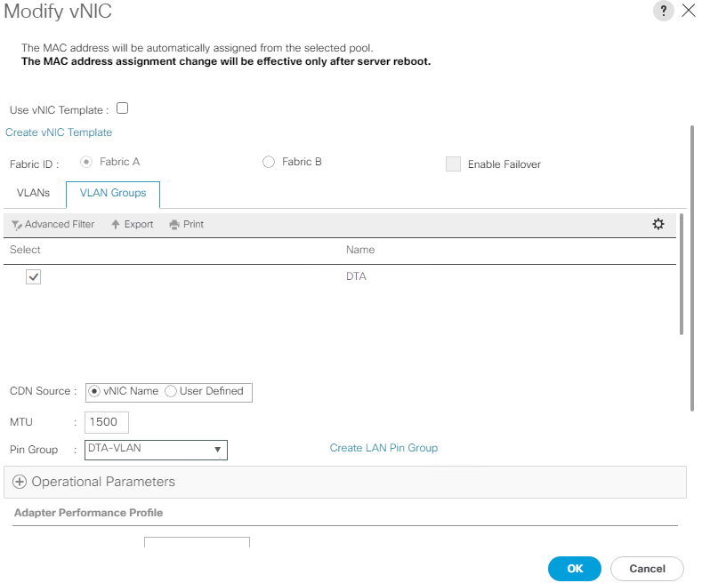
Associate the LAN Pin group to the vNIC template

